Slide 1
THE QUAD SQUAD
Yuting Li
Yifan Kang
Huaiqian Ye
Abhay Kavi Prakash

Slide 2
Agenda
Start | End | Item
0 Min | 3 Min | Introduction and pre-processing by Yuting Li
3 Min | 6 Min | EDA by Ye Huaiqian
6 Min | 9 Min | Modeling by Yifan Kang
9 Min | 12 Min | Insights and conclusion by Abhay K P
12 Min | 15 Min | Questions and Buffer time

Slide 3




Group members
Yuting Li – PR manager
Huaiqian Ye – Chief data scientist
Yifan Kang – Chief strategist
Abhay K P – Lord of Memes

Slide 4
Steps in Data Mining
Develop an understanding of the purpose of the data mining project
Obtain the dataset to be used in the analysis (Merging data)
Explore, clean, and pre-process the data (EDA)
Reduce the data dimension (Ex: Dropped uninformative variables)
Partition the data (60,20,20)
Choose the data mining techniques to be used
Use algorithms to fit models
Interpret the results of the algorithms (challenger-champion contest)
Deploy the model

Slide 5
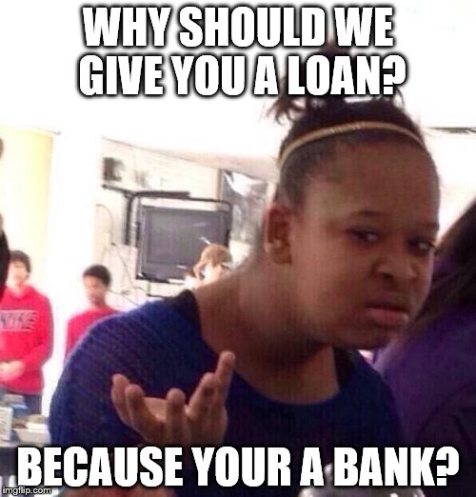
Aim
Describe all customers
Describe successful historical customers
Identify them within 1000 potential customers

Slide 6
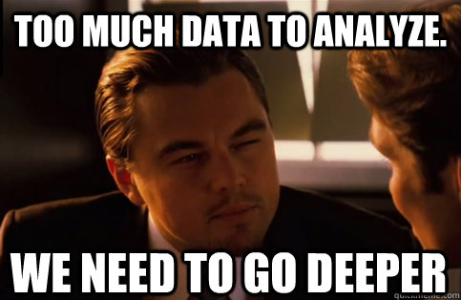
Data
Internal data
Household axiom data
Household credit data
Household vehicle data
Merging

Slide 7
Variables we have
"HHuniqueID"
"dataID"
"Communication"
"LastContactDay"
"LastContactMonth"
"NoOfContacts"
"DaysPassed"
"PrevAttempts"
"Outcome"
"CallStart"
"CallEnd"
"headOfhouseholdGender"
"annualDonations"
"EstRace"
"PetsPurchases"
"DigitalHabits_5_AlwaysOn"
"AffluencePurchases"
"Age"
"Job"
"Marital"
"Education"
"DefaultOnRecord"
"RecentBalance"
"HHInsurance"
"CarLoan"
"carMake"
"carModel"
"carYr"
"Y_AccetpedOffer"

Slide 8
Customer Description
Entire Population | Success Group
Mean of 2.607 number of contacts | Mean of 2.177 number of contacts
Mean of 48 days passed | Mean of 67 days passed
26% May 13% August 14% July | 18% May 12% August 13% July
50% Female | 48% Female
Median level 3 online | Median level 3 online
Mean age 41 | Mean age 42
Median bank balance 551 | Median bank balance 700
58% Married | 52% Married
Mostly management or blue collar or technician | Mostly management or blue collar or technician
50% Secondary education | 45% Secondary education
Most popular brands are Chevrolet and Ford | Most popular brands are Chevrolet and Ford

Slide 9
Categorize Variables
Identification
Categorical
Communication
Outcome
Numerical
NoOfContacts
headOfhouseholdGender
DaysPassed
PrevAttempts
annualDonations
PetsPurchases
DigitalHabits_5_AlwaysOn
AffluencePurchases
Age
Job
Marital
Education
DefaultOnRecord
RecentBalance
HHInsurance
CarLoan
carMake
carModel
carYr
Y_AccetpedOffer
HHuniqueID
dataID
EstRace
LastContactMonth
*CallDuration
Time
LastContactDay
LastContactMonth
CallStart
CallEnd

Slide 10
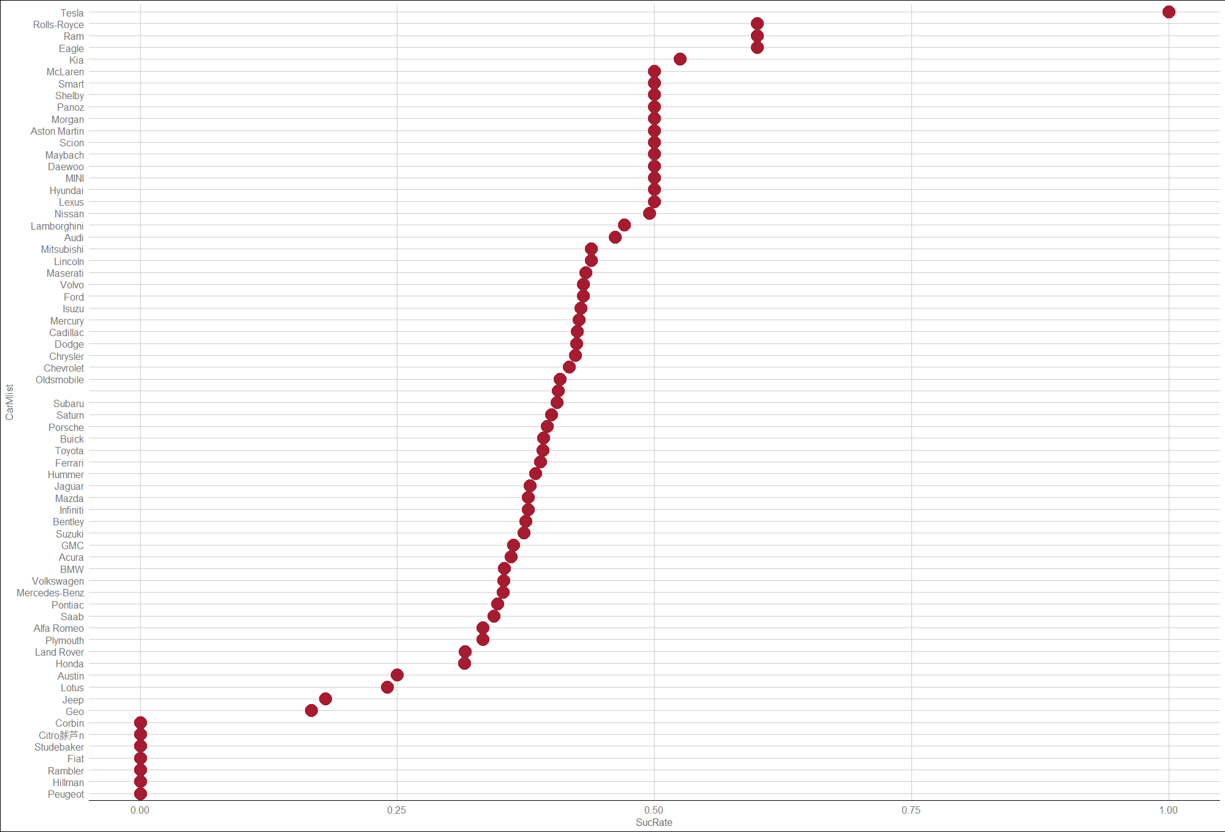
Loan Accept Rate of Different Car Makers

Slide 11

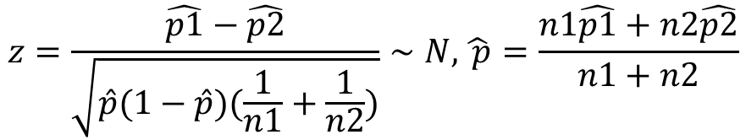
Significance Test (t-test)
Categorical
Communication
Outcome
headOfhouseholdGender
PetsPurchases
DigitalHabits_5_AlwaysOn
AffluencePurchases
Job
Marital
Education
DefaultOnRecord
HHInsurance
CarLoan
carMake
carModel
EstRace
LastContactMonth
Y_AccetpedOffer
$$z=\frac{\hat{p1}−\hat{p2}}{\sqrt{\hat{p}(1−\hat{p})(\frac{1}{n1}+\frac{1}{n2})}}∼N,\hat{ p}=\frac{n1\hat{p1}+n2\hat{p2}}{n1+n2}$$
To see whether the loan accept rate of
one category is significantly
different from the average
loan accept rate.

Slide 12
p-value of Loan Accept Rate of Different Categories
Categorical
Y_AccetpedOffer
Communication
Outcome
CarLoan
CarMake
DigitalHabits_5_AlwaysOn
Job
Marital
Education

Slide 13
Selecting Time Variables
Time
Numerical
Categorical
LastContactDay
LastContactMonth
CallStart
CallEnd
NoOfContacts
DaysPassed
PrevAttempts
annualDonations
Age
RecentBalance
carYr
*CallDuration
Y_AccetpedOffer
Communication
Outcome
CarLoan
CarMake
DigitalHabits_5_AlwaysOn
Job
Marital
Education
LastContactMonth

Slide 14
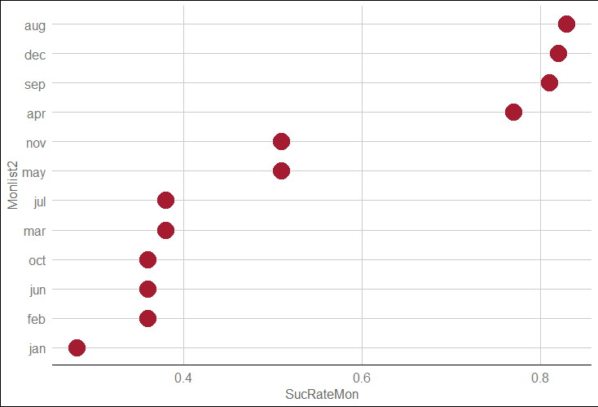
Loan Accept Rate of Different Month

Slide 15
Selecting Numerical Variables
Numerical
Categorical
NoOfContacts
DaysPassed
PrevAttempts
annualDonations
Age
RecentBalance
carYr
*CallDuration
Y_AccetpedOffer
Communication
Outcome
CarLoan
CarMake
DigitalHabits_5_AlwaysOn
Job
Marital
Education
LastContactMonth

Slide 16
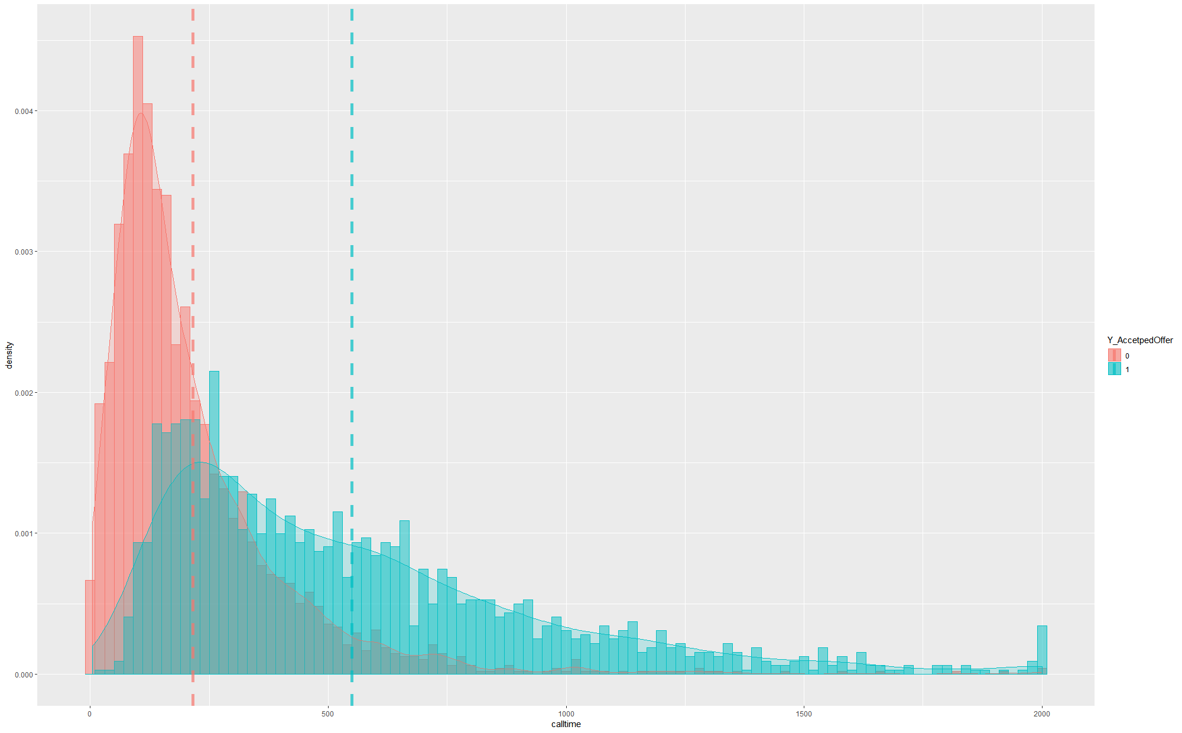
Call Duration Distribution of Customers

Slide 17
Variables we have after EDA
Identification
Categorical
Communication
Outcome
Numerical
NoOfContacts
DaysPassed
PrevAttempts
annualDonations
Age
RecentBalance
carYr
HHuniqueID
Y_AccetpedOffer
LastContactMonth
CarLoan
CarMake
DigitalHabits_5_AlwaysOn
Job
Marital
Education

Slide 18
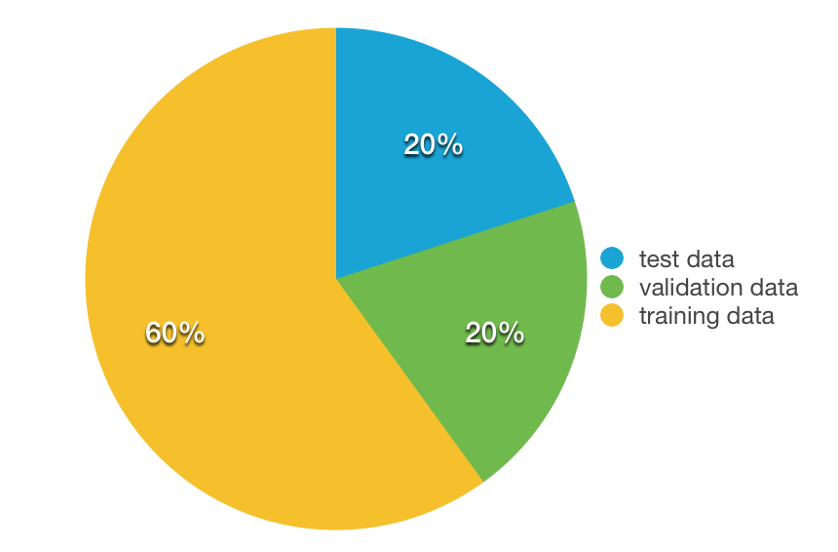

Partition

Slide 19
Choose a model
First, we build the following four models:
1 decision tree
2 random forest
3 k-nearest-neighbor
4 logistic regression
Then, we use accuracy based on validation set to decide
which one to choose.

Slide 20
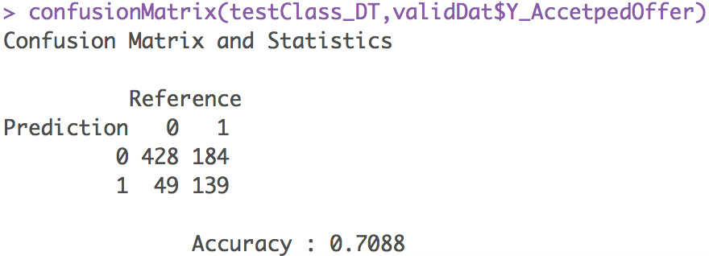
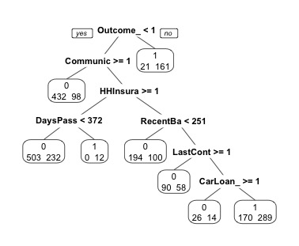
1. Decision Tree

Slide 21
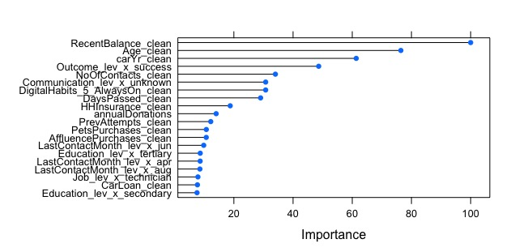
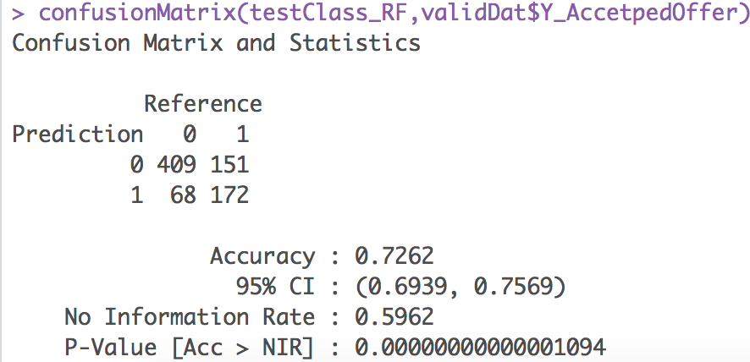
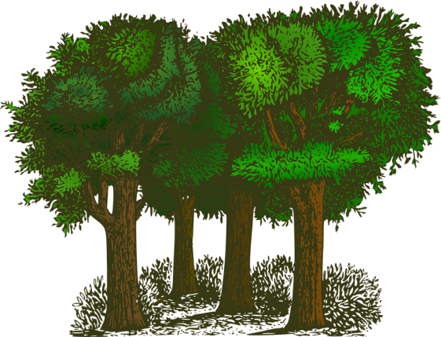
2. Random forest

Slide 22
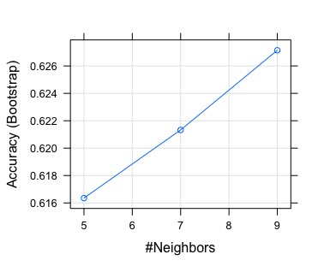
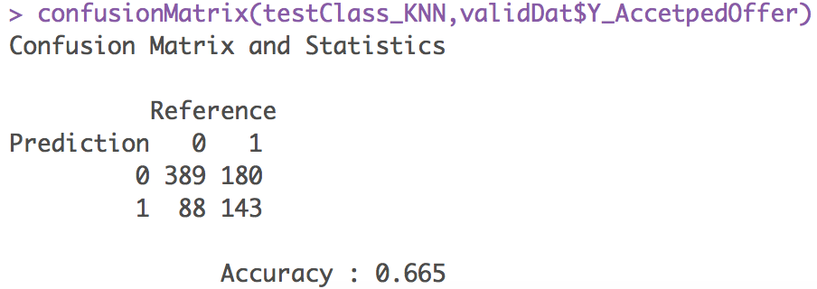

3 K-Nearest-Neighbor

Slide 23
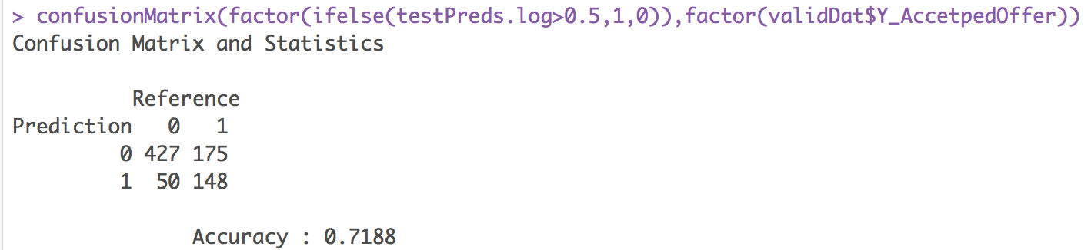

4. Logistic regression
1. logistic regression
2. Stepwise regression
Cutoff = 0.5

Slide 24
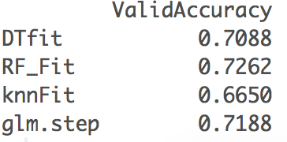
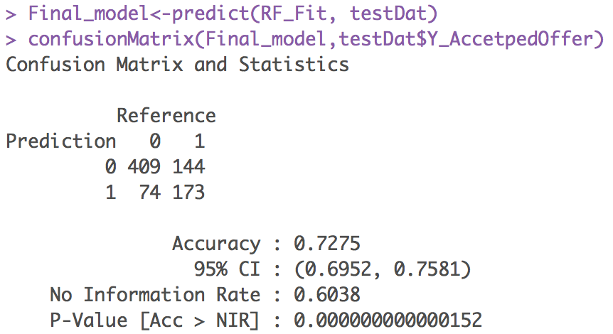
Choose the Random forest model

Slide 25

Why Particularly Random Forests?
Accurate
Properly fit
Makes sense

Slide 26
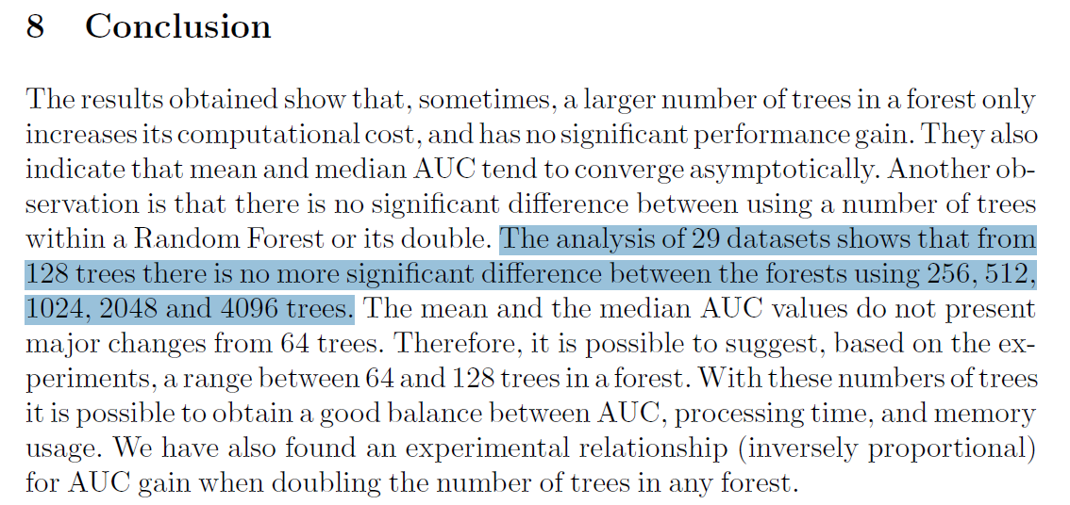
How many trees?
Reference:
“How Many Trees in a Random Forest?”
Thais Mayumi Oshiro, Pedro Santoro Perez, and Jos´e Augusto Baranauskas
Department of Computer Science and Mathematics Faculty of Philosophy, Sciences and Languages at Ribeirao Preto University of Sao Paulo

Slide 27
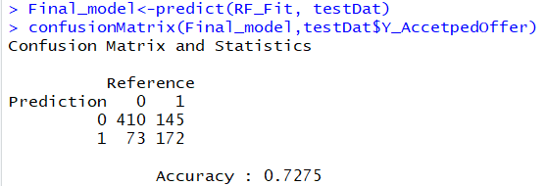
Testing on Test Set
Finalize the model
Significant difference in accuracy
No comparison

Slide 28
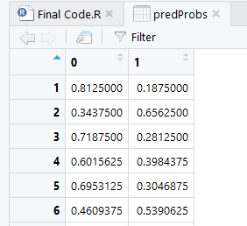
Now the real TASK!
Predict on the actual prospective customers
Find third party data and merge
Clean the data
Run the model
Don’t worry! You are doing this only once……

Slide 29
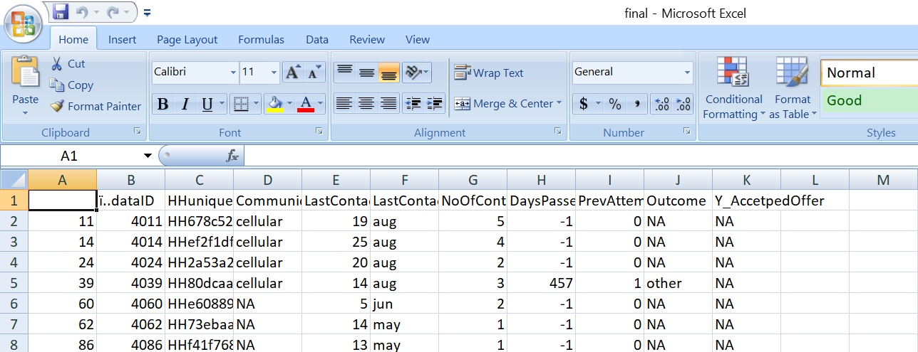
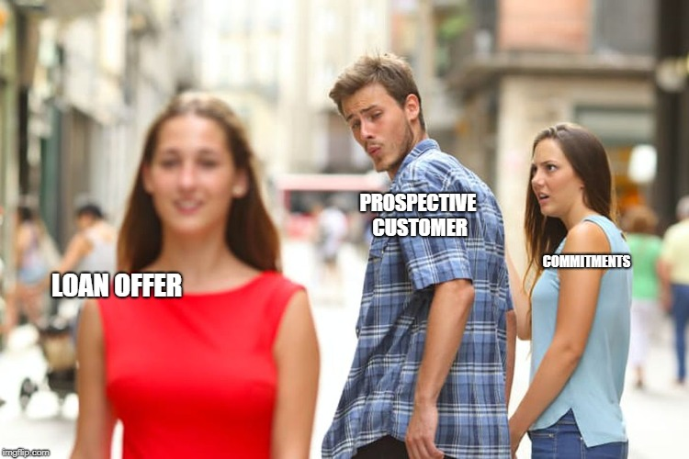
Ta Da!

Slide 30

Finally!
THANK YOU!
ANY QUESTIONS?

